Slide 1
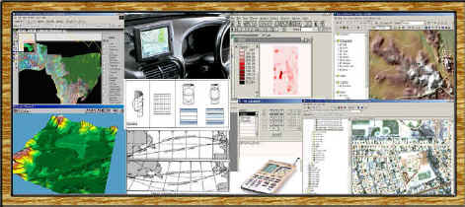
Geographic Information Systems
(GIS) for Epidemiology and Public Health
Dr. Ming-Hsiang Tsou
Department of Geography, San Diego State University
PPT slides: http://map.sdsu.edu/publications/GISpublichealthtsou.ppt

Slide 2
GIS is about geography and about thinking geographically.
--- Demers,
What is GIS ?
(Movies)

Slide 3

Acknowledgement
Thank Dr. Brett A. Bryan for the permission of using his slides and GIS examples (from The University of Adelaide, AUSTRALIA.
http://www.gisca.adelaide.edu.au/~bbryan/

Slide 4
What is “information”?
Data vs. Information (cooking example)
Example: weather information
What is “information system”?
Information System is a chain of operations incorporating data collection and digitization, data storage and analysis, and interpretation.
Examples: financial information systems (ATM).

Slide 5


GIS definitions
Demers, 2000: GIS are tools that allow for the processing of spatial data into information, generally information tied explicitly to, and used to make decision about, some portion of the earth.
    A data input subsystem
    A data storage and retrieval subsystem
    A data manipulation and analysis subsystem
    A reporting subsystem (data output)
    A data sharing mechanism

Slide 6
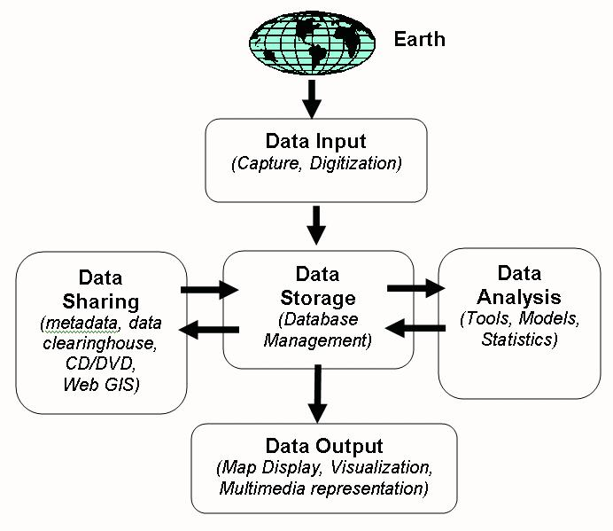

Slide 7
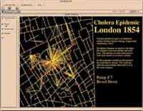
Medical Geography
Control of infectious disease very important
Disease control requires understanding
Geography can provide intelligence
Location can influence health
  John Snow's 1854 study – cholera mapping
Spatial analysis can assist in solving medical problems

Slide 8
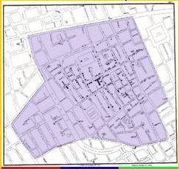
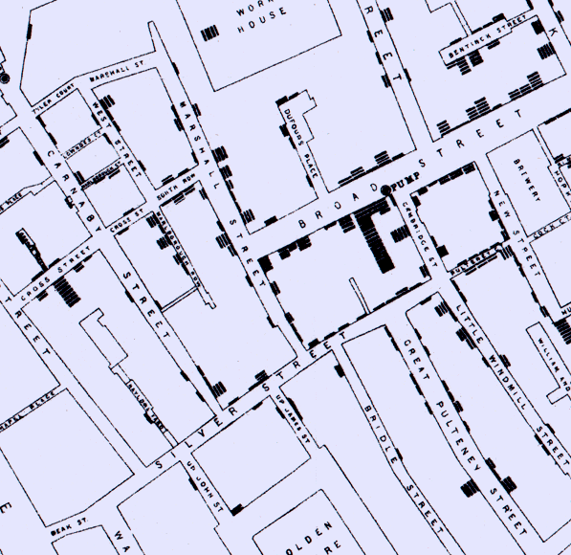
Dr. John Snow’s
London Street Map (1854)
http://www.ph.ucla.edu/epi/snow/Snowpart2_files/frame.htm (slide 10-15)

Slide 9
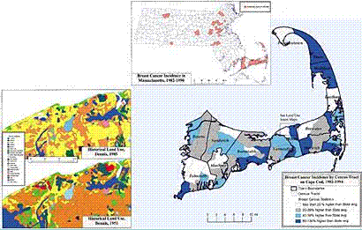
What GIS Can Do?
Integrate many different types of data
  Spatial data + Non-spatial data (statistical, texts,..)
With GIS we can easily:
  Draw maps and visualize spatial distributions
  Edit and alter existing data
  Accurately measure distances and areas
  Overlay maps of different areas
  Internet GIS for public access.

Slide 10
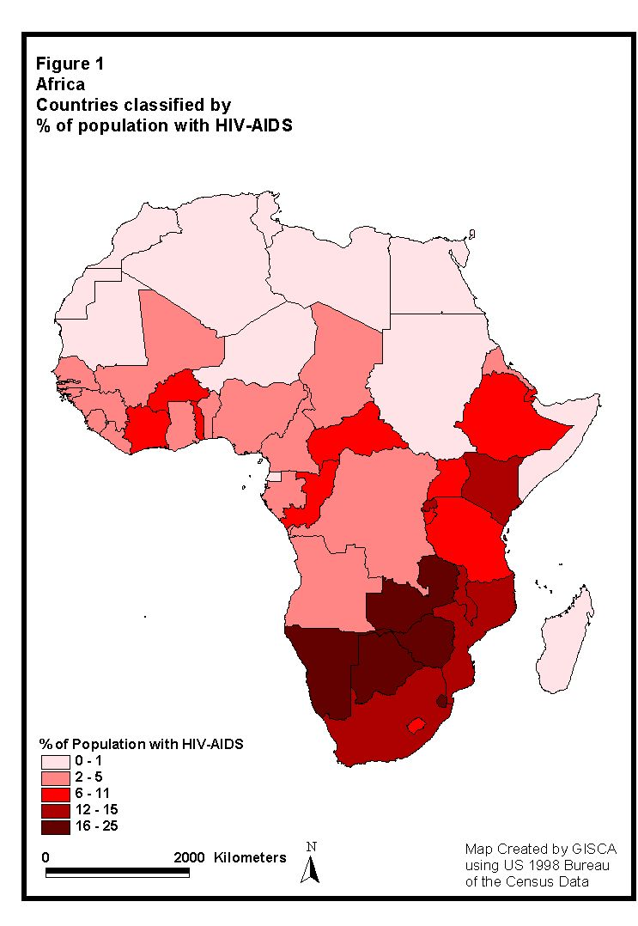
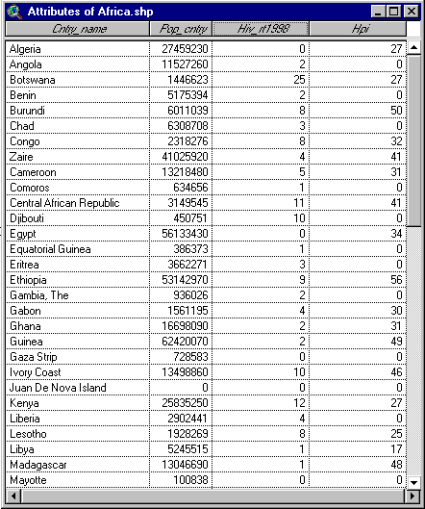
Combine
Geographic Locations with
Attribute Data

Slide 11
What GIS can help Public Health?
Research Tools and Planning
  Constructing mathematical models
  Service planning and optimisation
  Making predictions
Spatial Decision Support Systems
  Infrastructure – roads, towns, services
  Census – population statistics
  Medical resource (hospitals, clinics, available beds)
Emergency Response Systems
  Medicare records, 911 services
  disease registers systems

Slide 12
GIS Applications in Epidemiology
1. Data Visualisation and Exploration
2. Data Integration
3. Monitoring
4. Geostatistics and Modelling
5. Spatial Interaction and Diffusion
6. Data Sharing and Web Services

Slide 13
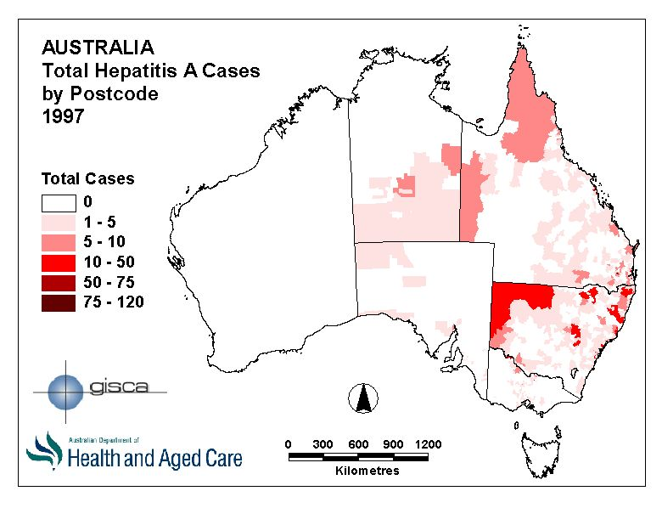
Data Visualisation and Exploration
2D visualisation capabilities – maps
  Distibutions
  Patterns
  Clusters
3D visualisation capabilities - surfaces
4D visualisation capabilities – temporal
  Animations
  Eg. Applied to spread/retreat of disease
Increases understanding of disease
Enables informed planning for disease management

Slide 14
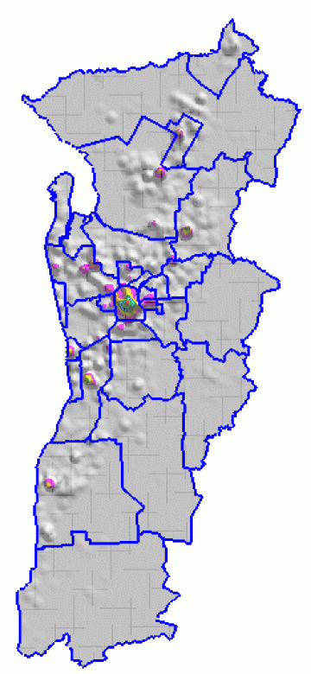
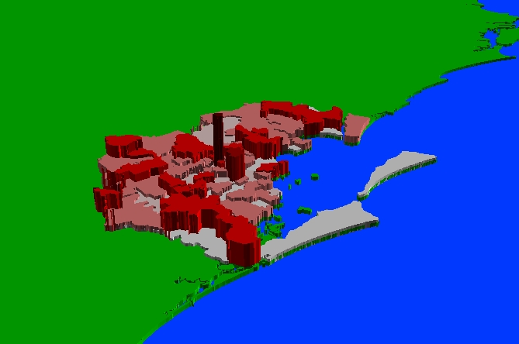
Example 3D
Visualization
Density
Surface
3D Extrusion

Slide 15
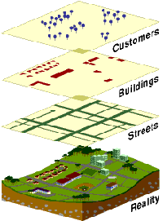
Data Integration
Thematic structure
Map Overlay
Compute new information
Research
  Integrated risk factor datasets to form risk model
  Used buffering, map algebra
  Able to predict likelihood of elevated blood lead levels, based on location of residence

Slide 16
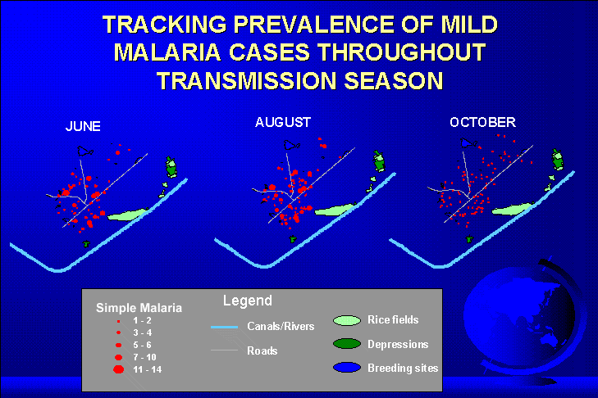
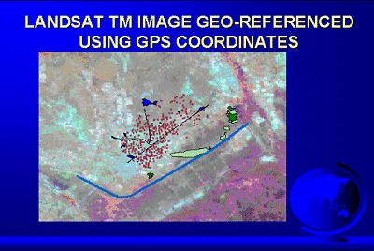
Temporal Change: Malaria

Slide 17
Monitoring
Monitoring – scrutiny over space and time
  Eg. Disease surveillance
Through surveillance, a picture of disease activity is developed
  Geographic distribution of disease
  Patterns, clustering and hot spots
GIS can provide data management and visualisation
WWW can disseminate this information in real time
Internet GIS ! (GEOG596 Internet Mapping)
Requirement – infrastructure and data update
SARS example.

Slide 18
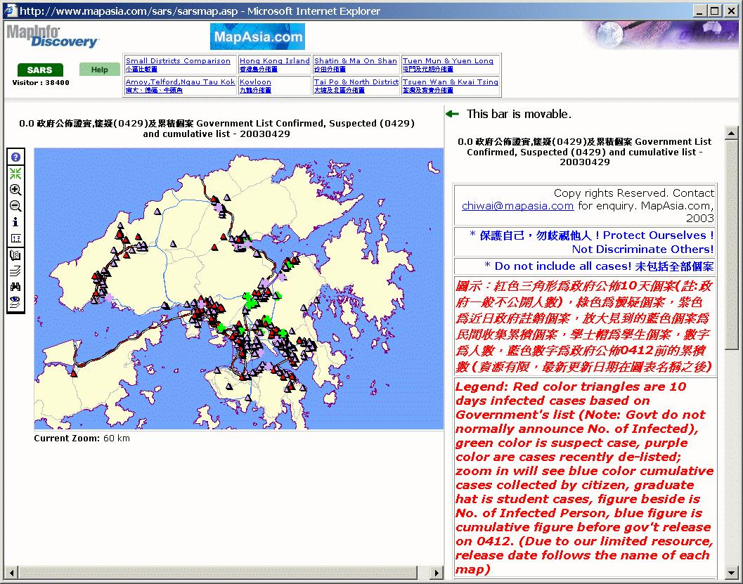

Slide 19
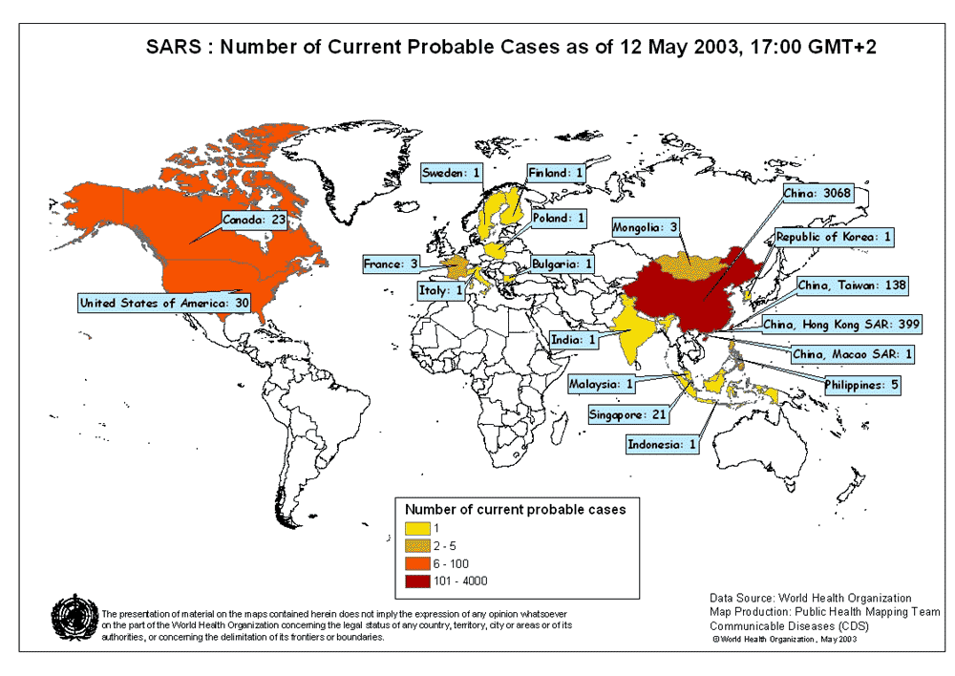

Slide 20
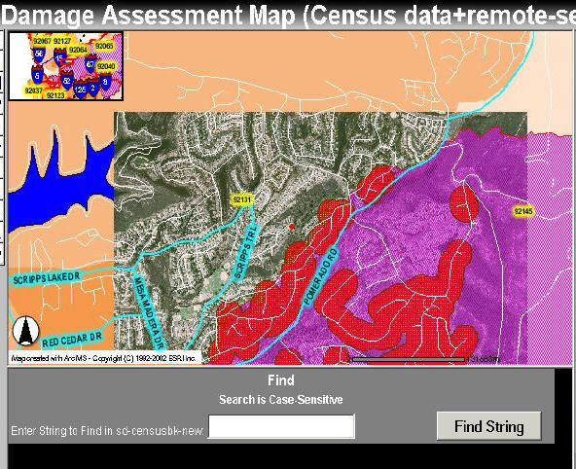
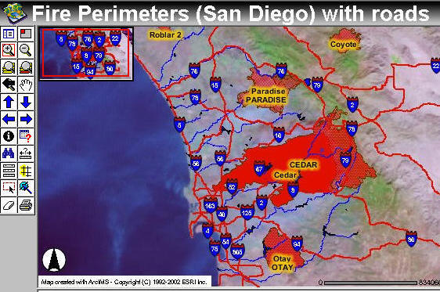
San Diego Wildfire 2003
Http://map.sdsu.edu
(GEOG 596) Internet Mapping

Slide 21
Geostatistics and Modelling
Explore statistical relationships in data
  Build geostatistical surfaces
  Detect clusters
  Significant change over time and space
  “Statistical Alarm Bell”
  Display outlier or influential cases by location
Statistical analysis also useful in finding zones of significantly higher disease prevalence

Slide 22
Investigating Dengue in Iquitos, Peru
(maps from Dr. Art Getis, SDSU faculty)
P
e
o
p
l
e
p
e
r
H
o
u
s
e
1
.
0
0
-
4
.
0
0
4
.
0
1
-
6
.
3
2
6
.
3
3
-
7
.
6
7
6
.
5
4
-
6
.
6
2
1
0
.
0
0
P
e
o
p
l
e
P
e
r
H
o
u
s
e
b
y
B
l
o
c
k
i
n
t
h
e
E
i
g
h
t
h
Q
u
a
r
t
e
r
N
0
1
2
K
i
l
o
m
e
t
e
r
s
Notes:
Reminder that we can look at different scales, this time the block scale. Remember that scale matters for instance a heavily infected block can make a whole zone appear heavily infected and to an extent that is what is happening in Maynas with the entomological indices.These blocks tend to have more containers possibly because the people are a little wealthier (less poor).

Slide 23
Geostatistics and Modelling (cont.)
Advanced spatial/non-spatial models can be built
Procedures such as regression, correlation, ANOVA
Variables may be:
  Non-spatial – Eg. smoking/non-smoking, occupation
  Spatial – Eg. proximity to factories
Test hypotheses about disease patterns
  Eg. Does low air quality increase likelihood of flu because of weakened respiratory systems?
  High density of flu cases in low air quality zones?

Slide 24
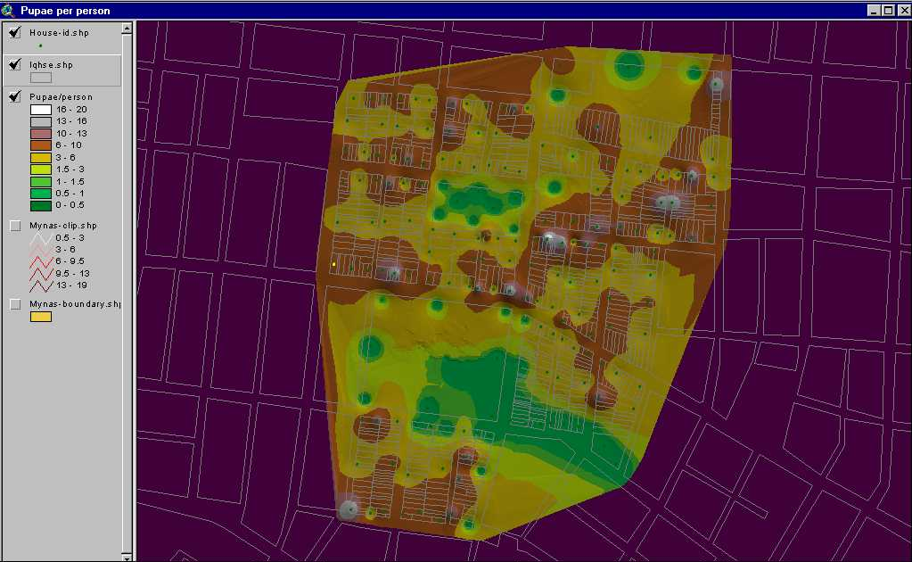
Modeling of Dengue Transmission
Pictures from Dr. Dana A. Focks http://www.id-analysis.com/pages/

Slide 25
Spatial Interaction and Diffusion
Used widely to help explain the spread of disease
Spatial interaction models
  analyse & predict flows central to disease transmission
  Eg. Model spread of flu by using interstate flight data & intrastate road travel
  Identify high risk pathways of disease transmission - target intervention
Spatial diffusion models
  Model spatial & temporal dimensions of disease spread
  Predict how diseases spread from source

Slide 26

Application Examples
GIS currently underutilized generally
Great potential in:
  Epidemiological research
  Communicable disease control
  Health service planning and optimization

Slide 27
Software Tools
ESRI ArcView (entry level use)
ESRI ArcGIS (ArcMap, ARC/INFO) advanced users
ESRI ArcIMS (Internet Map Server)
(www.esri.com)
GRASS (public domain software)
Autodesk Map2000, Intergraph GeoMedia

Slide 28
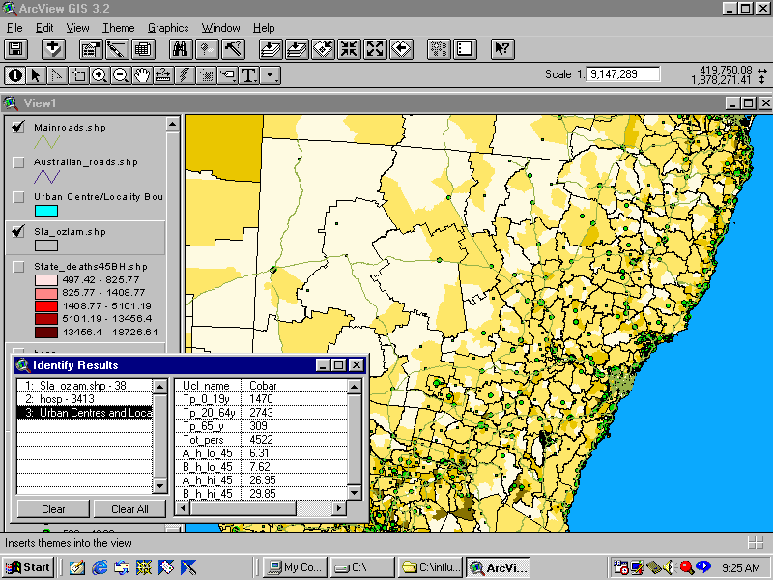
Hospitalisations at LGA, CDs, towns

Slide 29
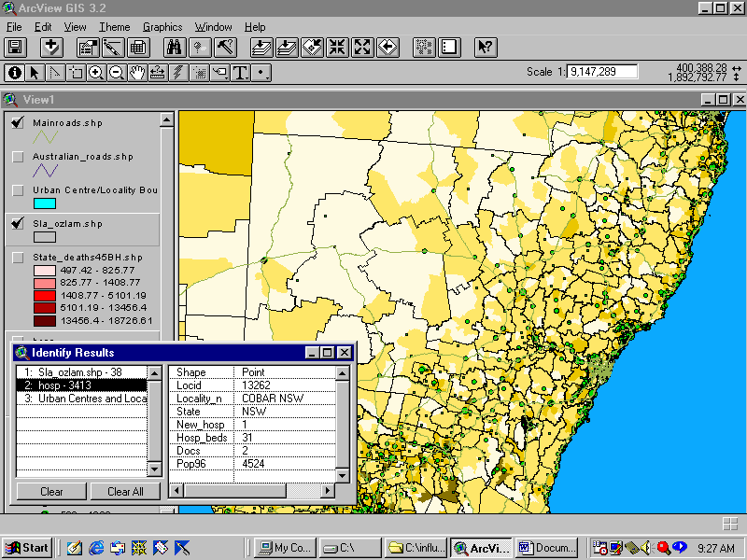
Integrating service data – hospital beds

Slide 30
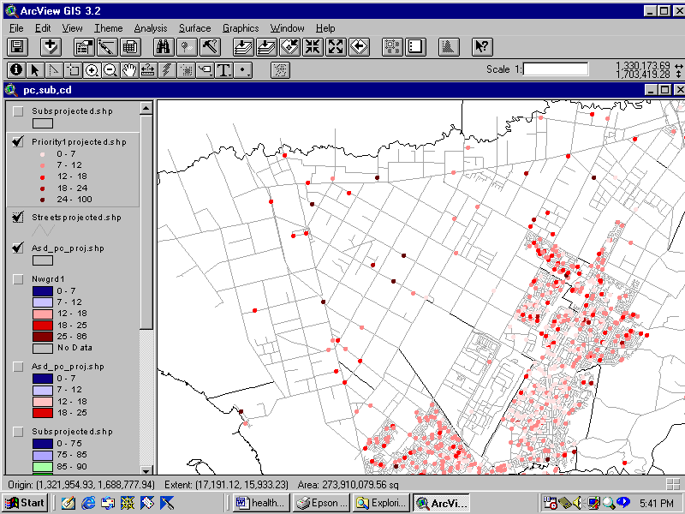
Unit record ambulance response rates

Slide 31
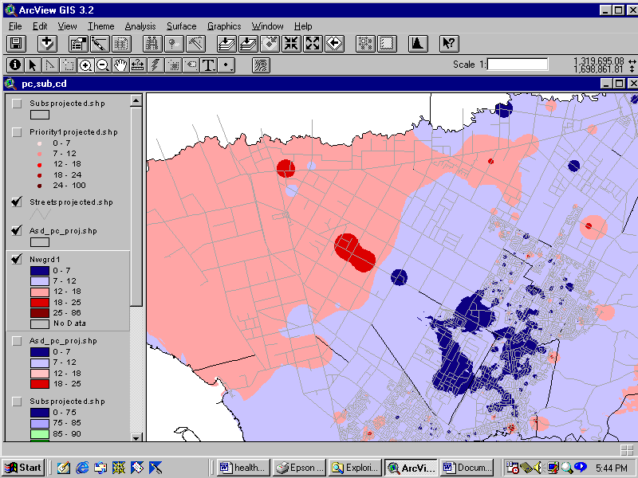
Surface building and hot spot analysis

Slide 32
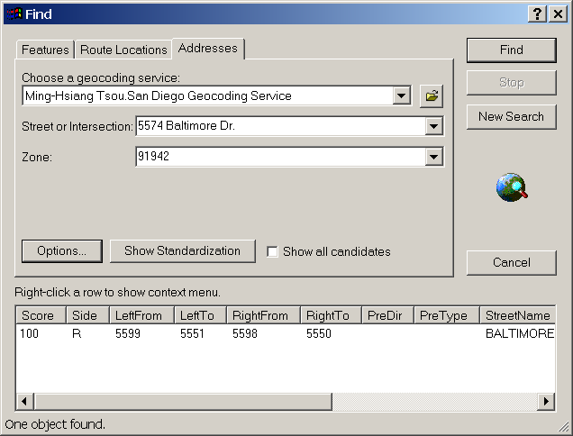
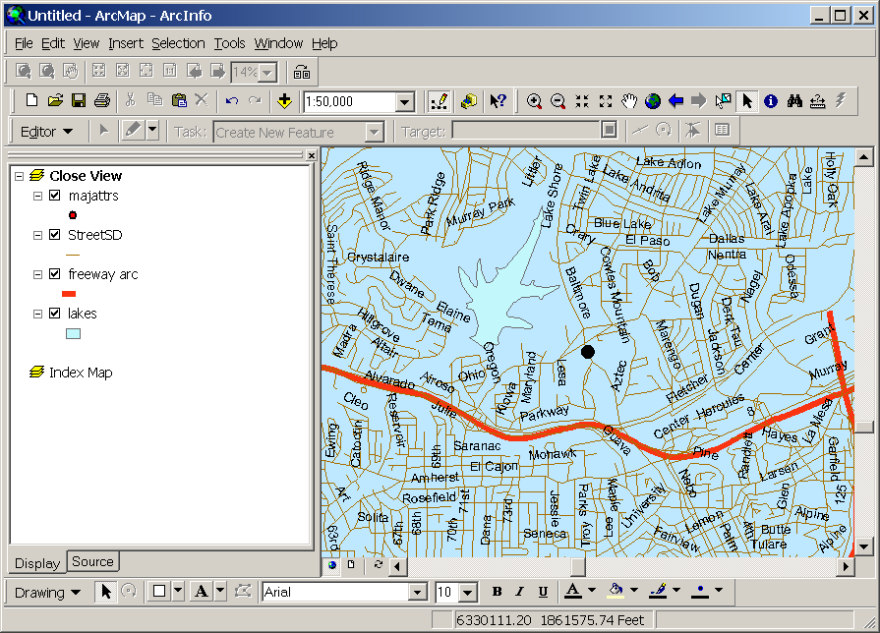
Address Matching
Convert patients’ addresses to the geospatial location on maps.

Slide 33
Limitations of GIS
Communication Gaps between epidemiologists & spatial professionals
Require uniform data standards
  Eg. Address recording 1/32 Main St. or Unit 1 32 Main St.
  Unit record data access
  Consistent and meaningful areal units
  Enable consistency & comparison
Privacy issues and spatial aggregation

Slide 34
Summary
GIS can provides spatial dimension to epidemiological research (visualization, modeling…).
GIS can be used for many public heath applications and services. (efficient allocation of health care resources, equity in accessibility to services…)
Internet GIS can provide the public health information in real-time. (evaluation, decision support systems, emergency response…)

Slide 35
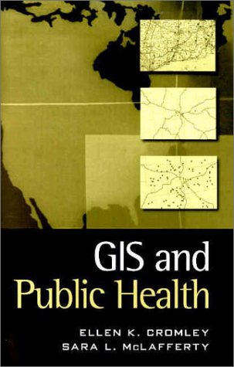
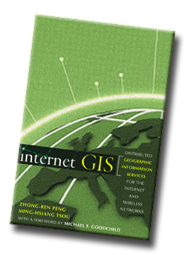
GIS Sources for Public Health
ESRI http://www.esri.com/industries/health/index.html
Books:
  GIS and Public Health by Ellen Cromley and Sara McLafferty. The Guilford Press. 2002.
  Internet GIS by Zhong-Ren Peng and Ming-Hsiang Tsou. Wiley, 2003.

Slide 36
GIS course in Geography, SDSU
GEOG 381 (Maps and Graphic Methods)
GEOG 484 (Intro GIS)
GEOG 584 (Intermediate GIS)
GEOG 596 (Internet Mapping)
  http://map.sdsu.edu/geo596
PPT slides: http://map.sdsu.edu/publications/GISpublichealthtsou.ppt

